Slide 1
BLADE COUNTER
BLADE COUNT (RUNNING):
B1
CURRENT BLADE:
B2
BLADE COUNTER
B3
B1
B2
B3
BLADE COUNT (RUNNING):

Slide 2
BLADE COUNTER
BLADE COUNTER
BLADE COUNT (RUNNING):
CURRENT BLADE:
B1
3
B2
2
B3
2
B1
TOTAL
7
23
B3
B2

Slide 3

Rotor_dia
Hub_ht
Location

Slide 4

SP_3
SP_3
SP_2
SP_4
SP_2
T_0
SP_1
SP_1
BLINC_IM - TOP VIEW
BLINC - TOP VIEW

Slide 5
SP_3
SP_3
SP_4
SP_4
SP_2
SP_2
SP_1
T_0
SP_1
T_0
BLINC_IM - TOP VIEW
BLINC_IM - TOP VIEW
CURRENT POSITION = SP_2

Slide 6
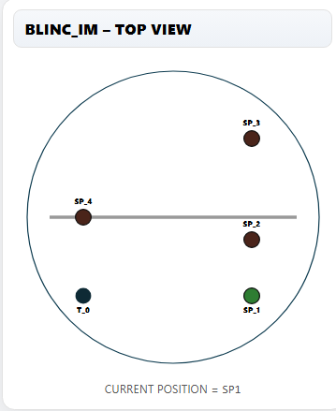
T_0

Slide 7
SCAN POSITIONS RECALCULATION BASED ON YAW
Working Radius 2D
SP_3
SP_3
SP_3
SP_4
SP_4
SP_4
SP_2
SP_2
SP_2
$$−θ$$
$$θ$$
TRACKER
SP_1
TRACKER
SP_1
TRACKER
SP_1

Slide 8
Y
Z
X
$$θ$$

Slide 9
N
Y
Z
X
W
E
Z
X
S
Y
CW + ve
$$θ$$

Slide 10
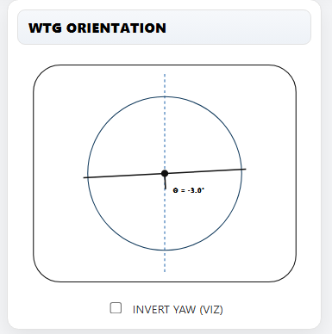
SP_3
SP_4
SP_2
TRACKER
SP_1

Slide 11
DIAGNOSTIC DATA

Slide 12
SIMULATION CONTROLS

Slide 13


BLINC-IM

